Slide 1

TOC
Phase1
Discover & Assess
Phase-2
Solution & Execution
Phase-3
Optimize
Demo
Merge the latest changes
Build latest changes
Appendix
Created by P Naga Kishore

Slide 2
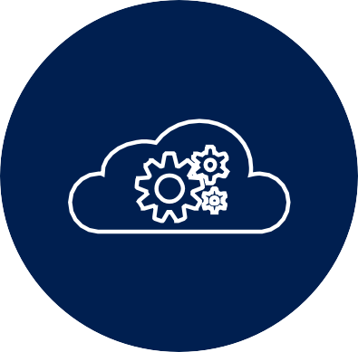
Key Considerations
Discover & Assess
Solution & Execution
Optimize
Understand the customer’s business objectives and assess the environment.
Access to existing Source Systems with there credentials
Required to Downloading one time load of historical data and also new files
Inventory very complex large-scale datasets in different formats which needed to be consumed and loaded in an automated and timely manner
Azure DevOps can help you Automate the Deployment of Data Factory from development to test environment that can easily be transitioned to any other environments you may have.
For this purpose I have set up a GitHub repository, two resource groups (development and test) in Azure and a project in Azure DevOps (Build, Test and Deployments).
Reasons to consider Azure DevOps for ETL Process: Collaboration, Work items, CI/CD, and Automation Testing.

Slide 3










Workflow
Azure Data Lake Storage
Resources Group
Azure Data Factory
Integration runtime
Azure DevOps
Sources Systems
Deploy
Testing
GitHub
Azure Repos
Build Pipeline
Release Pipeline
Deploy
Production

Slide 4

Approach Phase-1
Phase - 1
Activities:
Login into the Sources systems networks of customer`s
Download the process files and raw files from there database
And push the Datasets into the ADF with the help of MYSQL tool.
Backup the files of Datasets in the version control
Initiation:
Understand the customer’s business objectives and assess the environment
Inventory very complex large-scale datasets in different formats which needed to be consumed and loaded in an automated and timely manner
Inputs:
Access to existing Source Systems
Required to Downloading one time load of historical data and also new files
Tools:
Visual studios professional, and Manually download the files.
Deliverables:
Total processing files of Datasets
Total compressed size of database with additional files every day
Demo
What we do

Slide 5
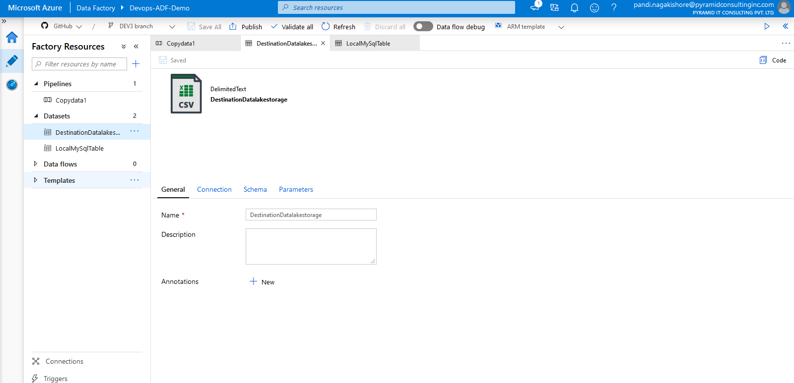
Phase – 1 (Discover & Assess)
Understand the customer’s business objectives and assess the environment.
Access to existing Source Systems with there credentials
Required to Downloading one time load of historical data and also new files
Inventory very complex large-scale datasets in different formats which needed to be consumed and loaded in an automated and timely manner

Slide 6
Approach Phase-2
Phase - 2
Activities:
Integrating Azure Data factory with GitHub.
Merging Azure Data factory with Azure DevOps.
Continuous Integration Build pipeline into Azure DevOps and kick off a build.
After CI deploys creates ARM templates Artifacts.
Create a release pipeline and deploy ARM templates artifacts into staging areas it to both test and Production environments.
Initiation:
Identify the most important assets that you need to migrate the Datasets as Source files.
Typically source code, work items, or both. Other assets in Azure DevOps Server - build pipelines, test plans, and so forth - are harder to manually migrate
Inputs:
Copy the important assets of files in the form of Datasets as source and Destination of pipeline of Azure Data factory
Establish the connection between ADF to Azure DevOps by using adf_publish branch.
Create Azure DevOps project and establish connections to all the systems.
Tools: Azure Data Factory, GitHub, and Azure DevOps.
Deliverables:
Initial work items is migrated to Azure Devops.
What we do

Slide 7
POC Roadmap
Stage 1 - Integrating ADF with Version Control
Saving your ADF code in a GitHub repository
Publishing changes to a Azure Data Factory and creating ARM templates
Stage 2 - Merging ADF with Azure DevOps
Integrate GitHub ADF repository to DevOps Project.
Generate a New Branch and merge with master branch and publish it
Stage 3 – Build Management
Stage 4 – Automation Testing
Stage 5 – Continuous Deployment
After CI deploys creates ARM templates Artifacts
Deploying it to both Testing and Production environments
Setting a GitHub Repository for your Azure Data Factory
Create Azure DevOps Project
Continuous Integration Build pipeline into Azure DevOps and kick off a build
Create a release pipeline and deploy ARM templates artifacts into staging area to test
Create a pull request and merge this change to the master branch of GitHub repository
we can see the changes in version control
Enable the “Continuous deployment trigger”
Adding changes to the existing ADF code
The test results will be associated this build and Testers

Slide 8


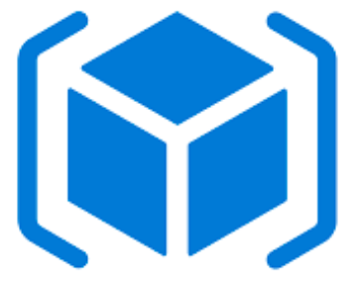
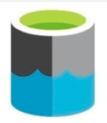
Architecture
Azure Cloud
Azure DevOps
adf publish branch
Resources Group
Data Factory
Data Lake Storage
Repos
Build
Release
Testing

Slide 9
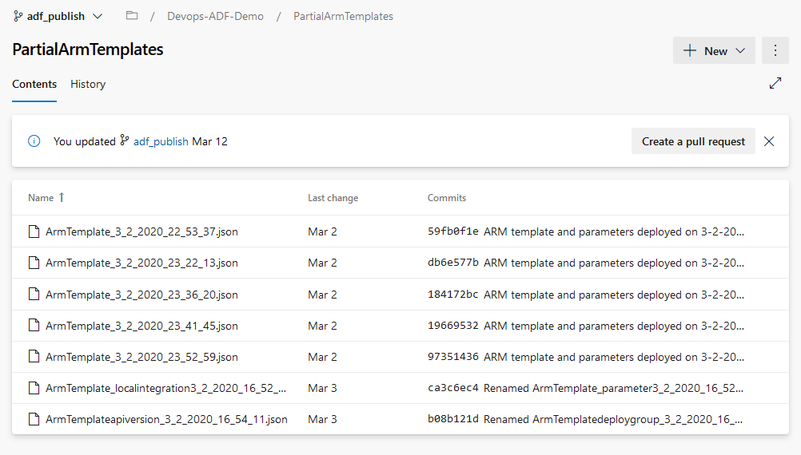
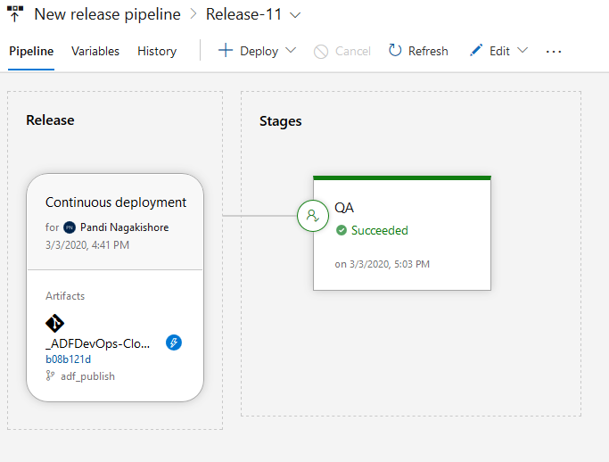
Execution
ARM Templates (Artifacts)
Release Pipeline

Slide 10
Approach Phase-3
Phase - 3
Activities:
Enable the “Continuous deployment trigger”
Create a pull request and merge this change to the master branch of GitHub repository.
we can use the GitHub as Backup of the Datasets And Datasets is reflects in the repository.
Deliverables:
Migrated Boards, work items, & backlogs.
Cost of Execution of Azure DevOps Services and Azure Data factory.
Initiation:
Track the Project backlog and issues by using Azure Boards.
Set up billing Azure Services
Inputs:
Validate migrated work items
What we do

Slide 11
Demo

Slide 12

ADF code change and its affect in DevOps pipeline
Changing ADF code
Merging the ADF code to your GitHub repository
Publishing / Creating ARM templates to deploy ADF code
Monitoring ADF code deployment
Validating code changes in other environments

Slide 13
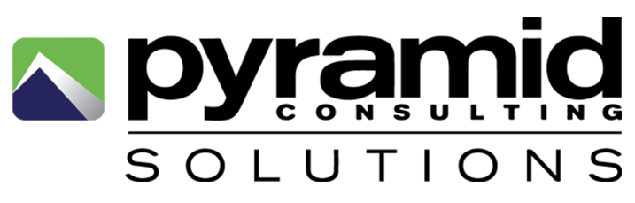
Appendix

Slide 14

Architecture of Azure Data Factory with Azure DevOps:
1-GIT
DEV Branches
3 –Azure CI/CD
Pull request
ADF DEV
Master Branches
Publish
2- Release Management
Created & updated by ADF
ADF Test
Publish Branches
Deploy as RM Environment
Release Definition
Pull as RM Artifacts
ADF Prod
Deploy as RM Environment
Release

